Slide 1
Policy-Driven Governance for Infrastructure Code

Slide 2
Common Pain Points
As environments grow, the risk of misconfigured infrastructure increases. Policy enforcement ensures that such misconfigurations are detected early in the development process.
Without centralized policies, different teams might implement security controls differently, leading to potentially weak security postures.
Scaling without policy enforcement leads to inconsistent resource management.

Slide 3
Benefits of Governance
The infrastructure is secure, following good practices such as encryption, proper network segmentation, and controlled access.
It adheres to organizational standards by maintaining consistent tagging for billing, ownership, and environment classification.
Resources are compliant with industry regulations and internal policies, helping to avoid costly oversights that could lead to vulnerabilities or regulatory fines.

Slide 4
Policy-Driven Governance with PaC
Instead of relying on manual checks, policy-driven governance automates these rules.
Policies are written as code and automatically enforced whenever a resource is defined or modified.
This proactive approach ensures governance is built into the deployment process from the ground up.

Slide 5
Desirable Traits
Proactive Governance: Policies allow the discovery of issues before they hit production, reducing security risks and operational inefficiencies.
Workflow Integration: Governance is baked into the infrastructure deployment process and is not left as an afterthought.
Automation and Scale: Manual checks don't scale; code does. Policies as code allow us to scale governance across multiple environments and teams.

Slide 6
What is OPA?
Open Policy Agent (OPA) is an open-source, general-purpose policy engine designed to enforce policies across different systems and environments.
The engine processes data in its native formats, while its rules language, Rego, allows for data analysis and transformation to make authorization decisions.

Slide 7
OPA decouples policy enforcement from core infrastructure and applications, creating a flexible and reusable framework. This separation of policy enforcement helps in:
building scalable software services
making them adaptable to changing business requirements
improving the ability to discover violations and conflicts
increasing the consistency of policy compliance
mitigating the risk of human error

Slide 8
How OPA works
Services delegate policy decisions to OPA by running queries. OPA determines policy decisions by assessing the query input against data and policies.
OPA's policies are expressed using Rego, a high-level declarative language designed for articulating policies over complex hierarchical data structures.
Policy decisions are not restricted to simple yes/no or allow/deny responses. Like query inputs, policies can produce various structured data as output.

Slide 9
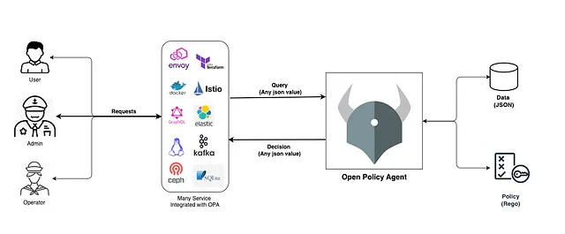
One of the remarkable aspects of OPA is its ability to integrate with a wide range of software systems, including cloud-native platforms, containers, and microservices.
This capability effectively enforces consistent policies across various areas of an organization's technology stack.

Slide 10
Governing Infrastructure Code
Key points to consider for effectively governing infrastructure code using OPA include:
Create a policy library to ensure quality, consistency, compliance, and reusability.
Store the policies as bundles in a repository or server (such as Azure Blob Storage, Amazon S3, ACR, GHCR, etc.).
Integrate the policy bundles with CI/CD workflows to enforce policies during deployment.

Slide 11
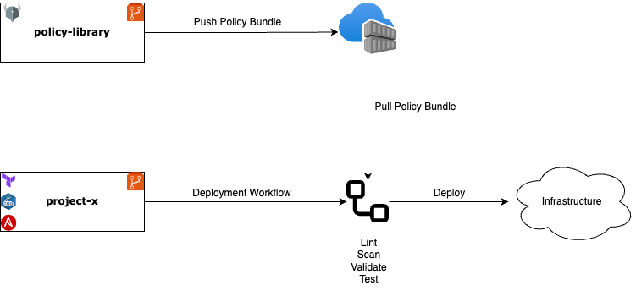
Example Architecture

Slide 12
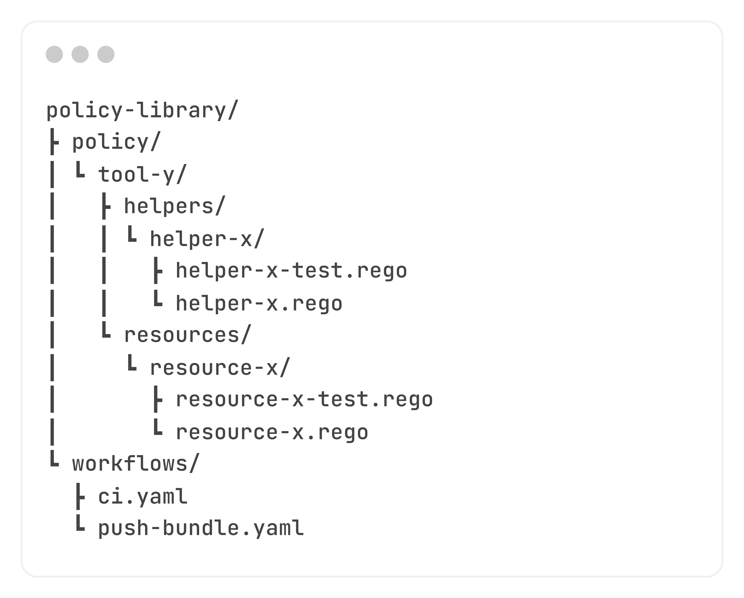
Possible Structure

Slide 13
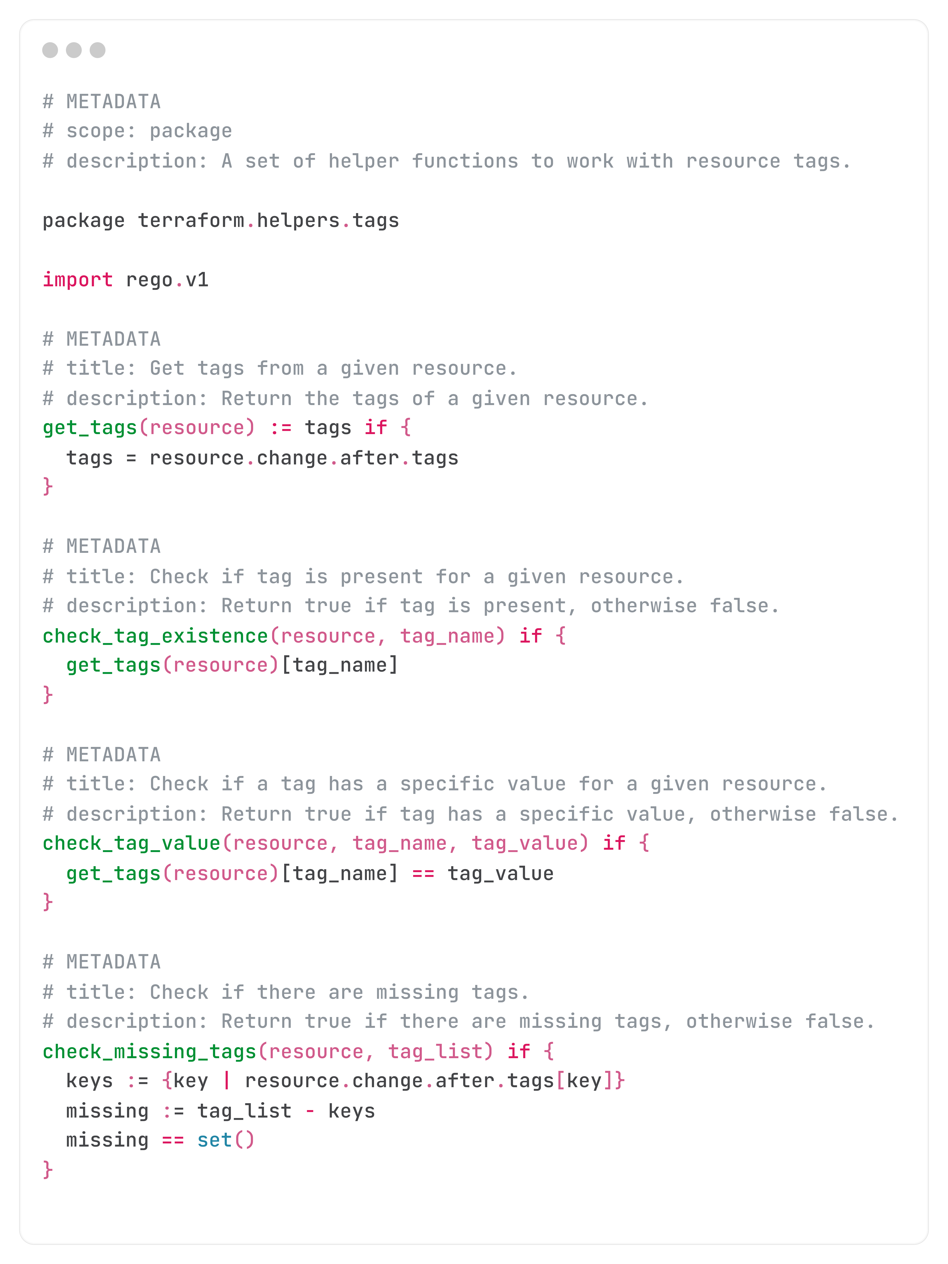

Slide 14
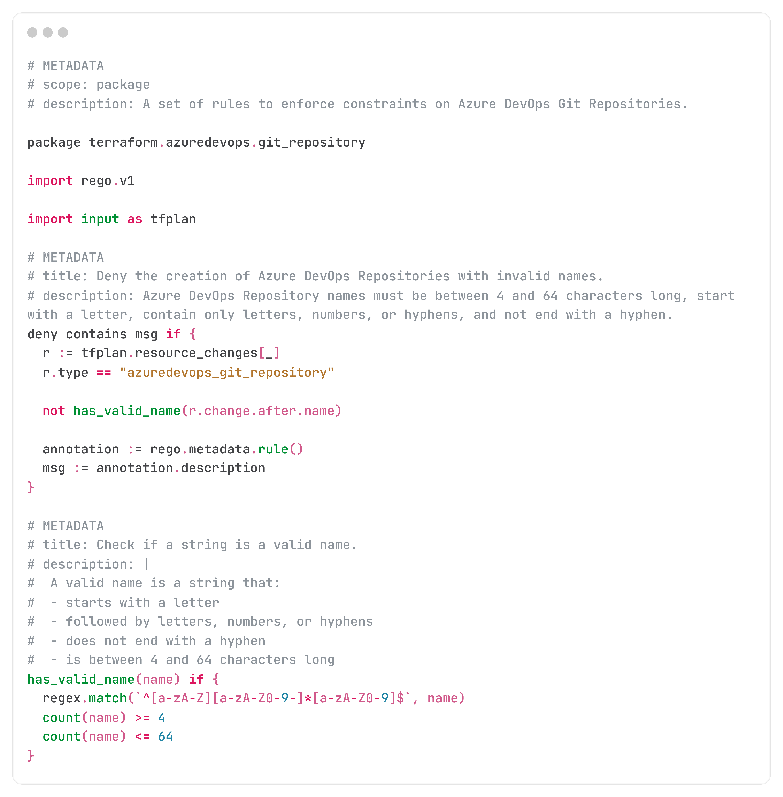

Slide 15
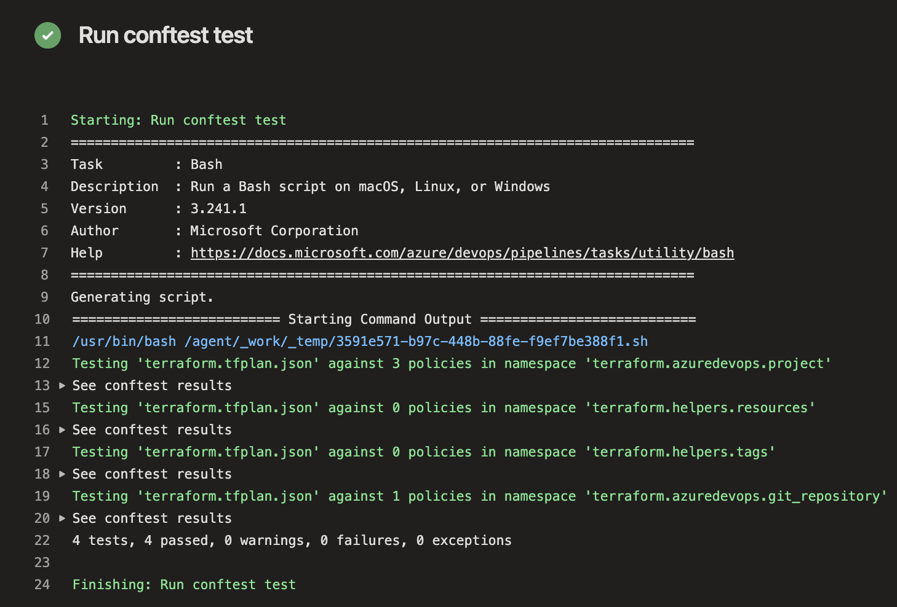

Slide 16
Good Practices
Follow the Single Responsibility Principle (SRP)
Adopt Modular Design
Test Extensively
Optimize Performance
Incorporate Logging and Monitoring
Regularly Review and Update

Slide 17
Key Takeaways
Importance of Governance: Effective governance is essential for ensuring security, compliance, and consistency in infrastructure driven by clear policies.
Flexible Framework: Implementing a tool-agnostic policy framework is imperative for ensuring flexibility and adaptability across diverse systems.
Centralized Policy Enforcement: Utilizing solutions like OPA enables centralized, policy-driven management across various technologies, simplifying governance and compliance.

Slide 18
Questions?

